Slide 1
Pediatric Inflammatory Bowel Disease
(IBD)
Disclaimer: I have no financial interests or conflicts of interest related to any of the material that I will present.

Slide 2

UC
CD
Ulcerative
Colitis
?
Crohn’s
Disease
Indeterminate Colitis
IC

Slide 3
Data from several contemporary studies will referenced in this presentation and compared. For simplicity, an abbreviation is assigned to each and will be listed in brackets.
[CR] CEDATA-GPGE registry:
Buderus S, Scholz D, Behrens R, et al. for the CEDATA-GPGE study group: Inflammatory bowel disease in pediatric patients—characteristics of newly diagnosed patients from the CEDATA-GPGE registry. Dtsch Arztebl Int 2015; 112:
121–7.
[MN] Multi-National:
Isabelle Cleynen et al, “Inherited determinants of Crohn’s disease and ulcerative colitis phenotypes: a genetic association”, Lancet 2016; 387: 156–67.
[SA] Saudi Arabia:
El Mouzan MI, et al, “Incidence of pediatric inflammatory bowel disease in Saudi Arabia: a multicenter national study”, Inflamm Bowel Dis. 2014 Jun;20(6):1085-90.
[WI] Wisconsin, a state in the USA:
Kugathasan et al, “Epidemiologic and clinical characteristics of children with newly diagnosed inflammatory bowel disease in Wisconsin : a state wide population-based study” , J Pediatr 143(4):525-531 (2003).

Slide 4
Item | [CR] | [MN] | [SA] | [WI]
Abbr for | CEDATA-GPGE registry | Multi-National | Saudi Arabia | Wisconsin
Region | Germany and Austria | 16 countries in Europe, North America, and Australasia | Saudi Arabia | Wisconsin, USA
Years | 2004-2014 | unstated | 2003-2007 , 2008-2012 | Jan 2000 - Dec 2001
Participants | 1257 | 29,838 | 340 | 199
Ages | < 18 years old | < 17 yrs, 17-40 yrs, > 40 yrs | 0-14 years old | < 18 years old
Study type | Prospective | Retrospective | Retrospective | Prospective
Source | 84 hospitals, clinics and practices | 49 Registry Centers | 20 Gastroenterology Centers | 6 academic ,5 community centers
Study | Document diagnosis and treatment | Genetic, Immunochip genotype Illumina genotyping platform, 195,806 polymorphism | Population study | Population study

Slide 5
UC vs Crohn’s, Macroscopic*
* Pathology of Pediatric Gastrointestinal and Liver Disease, 2nd Ed, ©2014. Edited by Pierre Russo, Eduardo D. Rucelli, and David A. Piccoli,

Slide 6
UC vs Crohn’s, Microscopic *
•Mucus depletion
* Pathology of Pediatric Gastrointestinal and Liver Disease, 2nd Ed, ©2014. Edited by Pierre Russo, Eduardo D. Rucelli, and David A. Piccoli,

Slide 7
Subphenotypes of IBD – by Genetic Studies
49 centers in 16 countries in Europe, North America, and Australasia
29,838 patients (16,902 - Crohn’s disease, 12,597 - ulcerative colitis).
Genetic studies have identified 163 susceptibility loci for inflammatory bowel disease, mostly shared between Crohn’s disease and ulcerative colitis.
“Three loci (NOD2, MHC, and MST1 3p21) were associated with subphenotypes
of inflammatory bowel disease, mainly disease location”
“Our data support a continuum of disorders within inflammatory bowel disease, much better explained by three groups (ileal Crohn’s disease, colonic Crohn’s disease, and ulcerative colitis) than by Crohn’s disease and ulcerative colitis as currently defined.”
Isabelle Cleynen et al, “Inherited determinants of Crohn’s disease and ulcerative colitis phenotypes: a genetic association”, Lancet 2016; 387: 156–67.

Slide 8
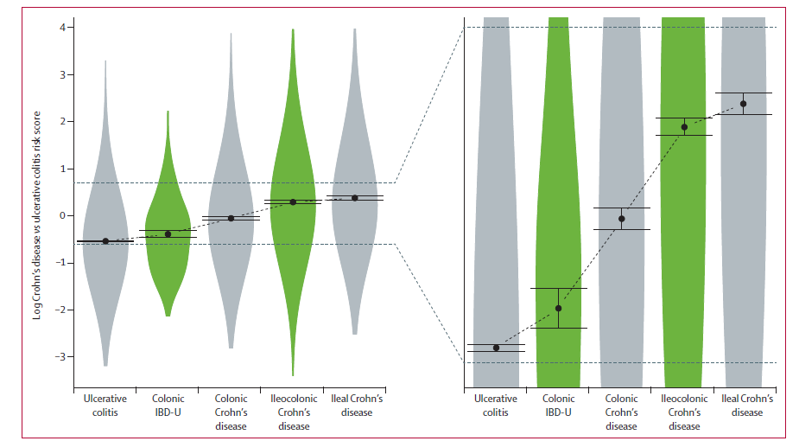
163 susceptibility loci used to make a risk score (negative favors UC, positive favors CD)
Scores predicted disease location along a continuum.
Isabelle Cleynen et al

Slide 9
Etiology not understood well - Inappropriate immune response (microbial or food) in genetically susceptible host.
- Proinflammatory cytokines TNF-α, IL-1β, Inf-γ, and IL-23 / IL17A pathway.
- Anti-Inflammatory cytokines, Dysfunction of IL-10 and its receptor.
More common in industrialized societies, possibly from a less educated gut immune system.
Incidence of IBD in first degree relatives:
- in patients < 5 yrs old = 56%
- in patients < 20 yrs old = 30%
25-35% of IBD patients have extraintestinal disease:
- arthritis (7-25%), transient, nondeforming synovitis, asymmetric, common in knees
- ankylosing spondylitis (2-6%), HLA-B27
- erythema nodosum (3% pediatric CD when active, anterior legs)
- pyoderma gangrenosum (< 1%, indolent chronic ulcer, can be in remission)
Pathology of Pediatric Gastrointestinal and Liver Disease, 2nd Ed, ©2014. Edited by Pierre Russo, Eduardo D. Rucelli, and David A. Piccoli

Slide 10
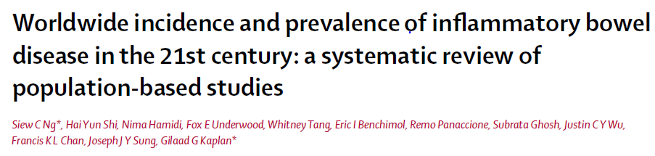
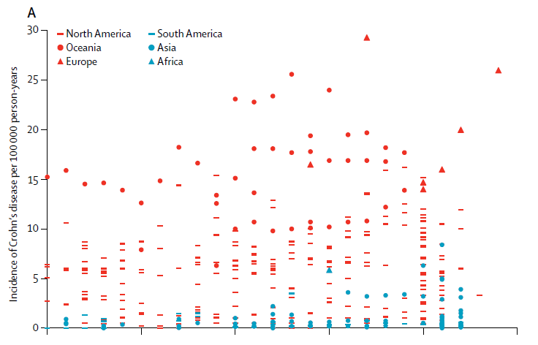
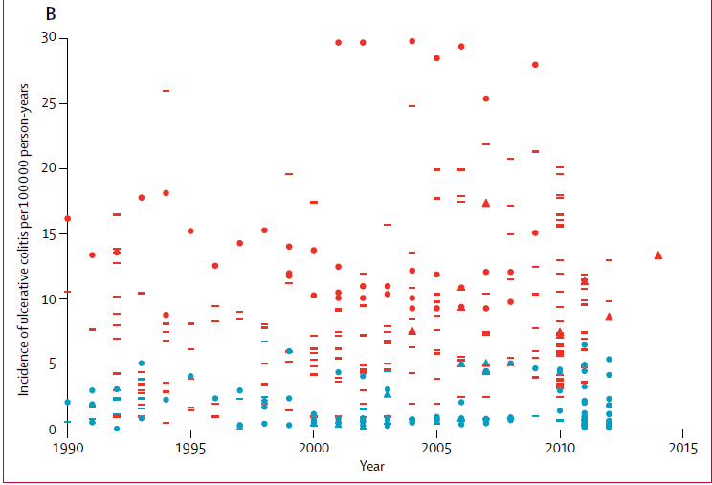
The Lancet, published online October 16, 2017
Incidence of IBD rose in North America and Europe latter half of 20th century until 1990 when plateaued or decreased. At the same time, since 1990, the incidence is on the rise in newly industrialized countries.

Slide 11
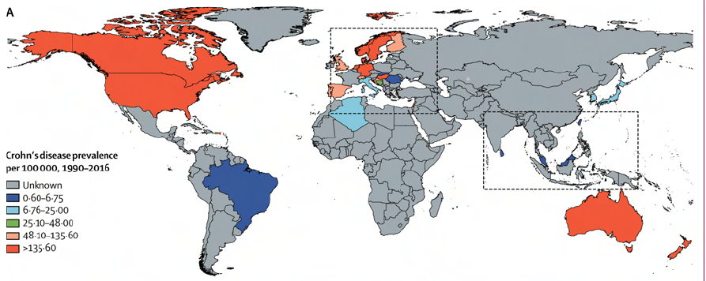
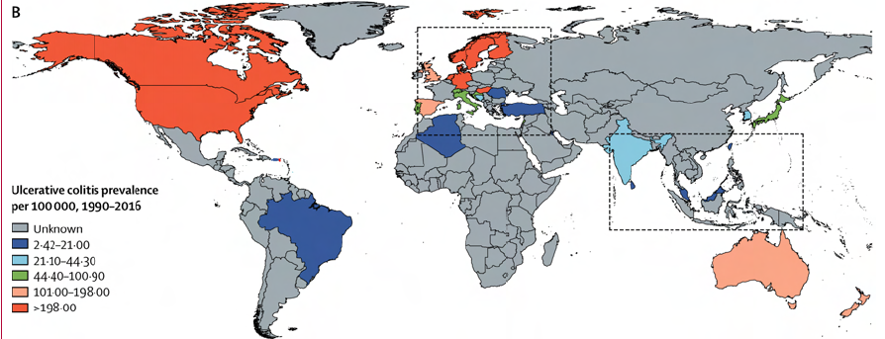

Slide 12
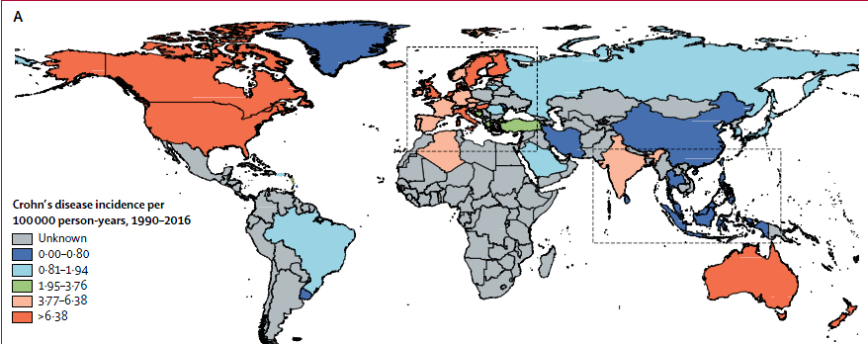
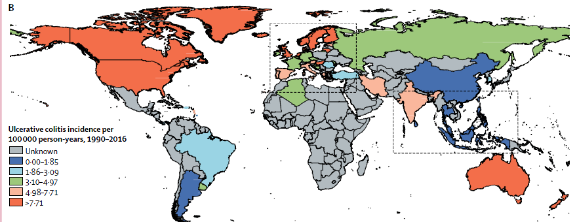

Slide 13
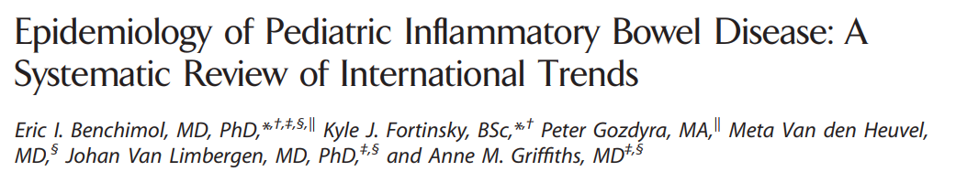
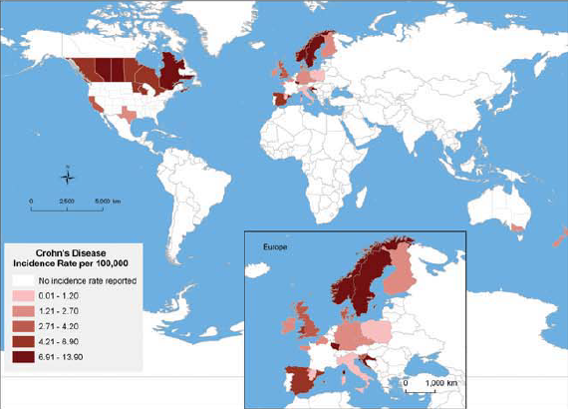
Inflamm Bowel Dis 2011;17:423-439 Literature: 139 studies from 32 countries

Slide 14
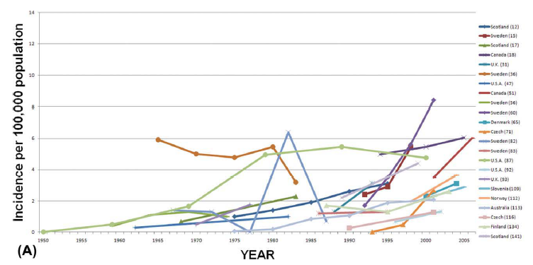
Crohn’s Disease Incidence from 1990 to 2010

Slide 15
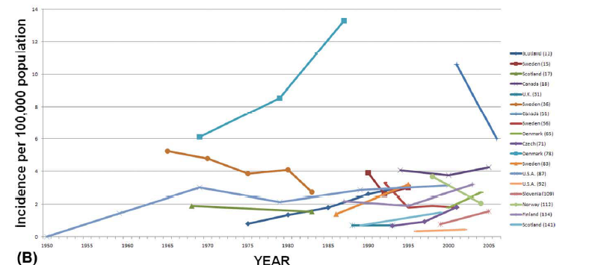
Ulcerative Colitis Incidence from 1990 to 2010

Slide 16

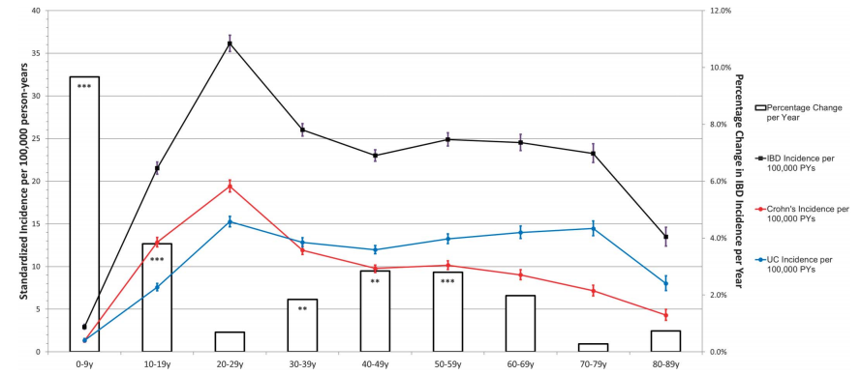

Slide 17
Differences in Children vs Adults
Adults
Children
Cryptitis and crypt abscesses most likely IBD.
Crohn’s more commonly ileal and proximal colon.
Ulcerative colitis usually distal colon.
Present with growth failure.
Cryptitis and crypt abscesses might be self limited colitis.
Genetic factors in early onset IBD.
Family history in 40% of affected children.
Crohn’s colitis more prevalent in children.
Ulcerative colitis is pan colitis.
Isolated ileal disease less in younger.
More strictures and fistulas.
Shorter time from diagnosis to colectomy.
More frequently progress from limited to extensive disease.

Slide 18
Rectal Sparing (RS) in Children
In adults, UC tends to start in rectum and proceed proximally in a confluent fashion.
Absolute RS – no inflammation or chronicity
Relative RS – inflammation but no chronicity
In various studies up to 25% of children with ulcerative colitis have relative rectal sparing, many fewer absolute.

Slide 19
IBD vs Acute Self Limited Colitis (ASLC)
Diarrhea lasting for more than a few weeks without identification of a pathogen more likely to have IBD. Salmonella, Campylobacter, Yersinia may be found in upto 15% of patients with IBD. (G Schumacher, “First attack of inflammatory bowel disease and infectious colitis. A clinical, histological and microbiological study with special reference to early diagnosis”, Scand J Gastroenterol Suppl. 1993;198:1-24.)
ASLC
- no signs of chronicity
- neutrophils in superficial mucosa, sometimes with small ulcers
- cryptitis and crypt abscesses may occur
- numerous crypt abscess may be UC, CD, or C. difficile.
New onset IBD
- in adults will show chronicity (branching, shortening, dropout, basal plasmacytosis)
- in pediatric patients 10-34% show no signs of chronicity (especially <10 years old)
- in pediatric patients, Paneth cells in 11/13 UC and 14/15 CD and none in controls*
- in pediatric patients Paneth cell metaplasia anywhere in colon only seen in IBD, and not
necessarily with inflammation – not associated with chronicity.
(more than 10 Paneth cells per 10 crypts)*
Naomi Simmonds, et al, “Paneth cell metaplasia in newly diagnosed inflammatory bowel disease in children”, Gastroenterology 2014, 14:93.

Slide 20
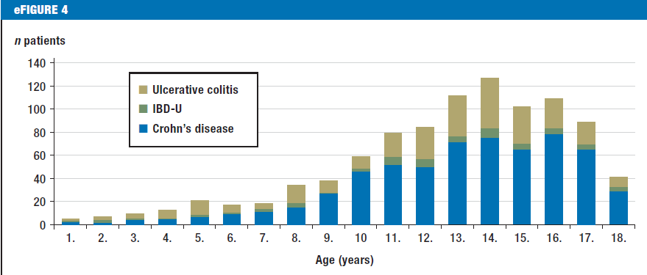
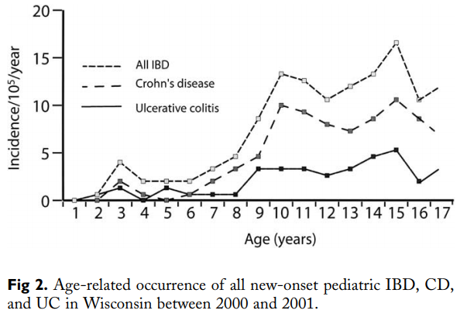
[CR]
[MN] - X
[SA]
0-4 yr 15.9%
5-9 yr 31.5%
10-14 yr 52.6%
[WI]
Equal distribution among all racial and ethnic groups
No modulatory effect of urbanization
Possibly environmental factors
†

Slide 21
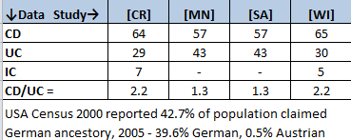
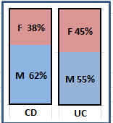
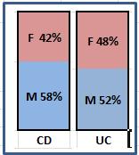
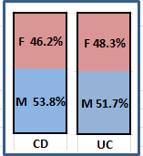
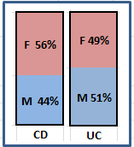
Percent of IBD – CD, UC, IC
Distribution by Gender
[WI]
[CR]
[SA]
[MN]

Slide 22
Ileal inflammation can be backwash ileitis (<10 cm involved,
no thickening, no stenosis of ICV, no granulomas ).
Upper GI involvement in up to 30% of CD.
Upper GI findings (granulomas in stomach) may compel a diagnosis change from a previous lower GI study.
Reflux and H pylori do happen in context of IBD.
“Focal Enhanced Gastritis” (perifoveolar or periglandular mononuclear or
neutrophilic infiltrates) favor CD over UC: CD (52%)/UC (8%) *;
CD (43%)/UC (12%)/Cntrl (19%)†; CD (65.1%)/ UC (20.8%)/ Ctrl
(2.3%)/ HP(2.6%) ‡.
* P. S. Kundhal, “Gastral Antral Biopsy in the Differentiation of Pediatric Colitides”, Am J
Gastroenterol 2003;98:557–561. © 2003
† Fabrizio Parente, M.D., “Focal Gastric Inflammatory Infiltrates in Inflammatory Bowel Diseases:
Prevalence, Immunohistochemical Characteristics, and Diagnostic Role”, Am J Gastroenterol 2000;95:705–711. © 2000
‡F. Sharif, “Focally Enhanced Gastritis in Children With Crohn’s Disease and Ulcerative Colitis”, Am J
Gastroenterol 2002;97:1415–1420. © 2002

Slide 23
Superficial inflammation in the appendix (cryptitis and crypt abscesses)
and no transmural inflammation, sometimes in UC.
Do not overcall loose or mucin granulomas as CD.
Tuberculous granulomas tend to be multiple, large, caseous.
Yersina, Schistosomes, CGD other considerations.
Marked reduction in plasma cells – possible immune deficiency.
- Absence of goblet or Paneth cells – autoimmune.

Slide 24

Mark Luquette, M.D.
University of Minnesota, USA
LUQUE007@umn.edu
Lectures at: IBDregistry.net
Thanks to:
Boris Sudel, M.D.
Pediatric Gastroenterologist
Director of Inflammatory Bowel Disease Center
at University of Minnesota Children’s Hospital

